Slide 1
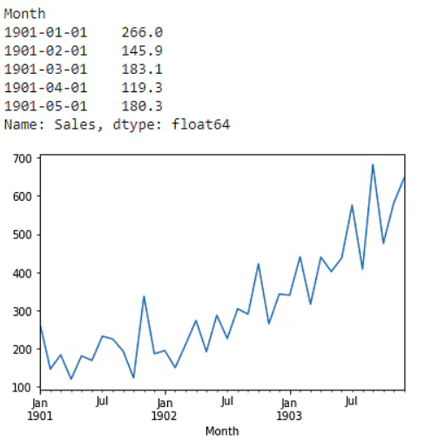
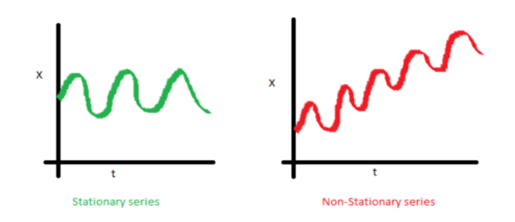
Time Series Analysis
What is a time series model?
A time series model is a set of data points ordered in time, where time is the independent variable.
when dealing with time series:
Is it stationary?
Is there a seasonality?
Example:
Stationary: Flip of coin, Customer transactions at a store, demand for a particular product (chips, snacks items etc), Covid-19.
Seasonality: Consumption of electricity, Sales in festivals or Holidays, Vacation during the December-January time.
Example: Time Series
Vary with time
Do not vary with time

Slide 2
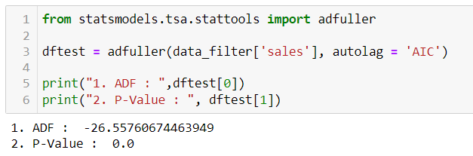
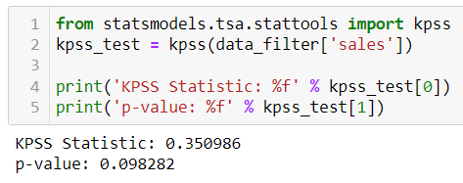
How to check data is stationary or not ?
There are few statistical tests for identifying trends and stationarity in time series:
Dickey-Fuller test.
KPSS (Kwiatkowski-Phillips-Schmidt-Shin) Test.
Dickey-Fuller test. | KPSS (Kwiatkowski-Phillips-Schmidt-Shin) Test.
The Dickey-Fuller test is a statistical test used to evaluate whether a time series is stationary or not. H0: Time Series is non-stationary. H1: Time Series is stationary. | It is another statistical test used for checking the presence of stationarity. H0: Time Series is stationary. H1: Time Series is non-stationary.

Slide 3
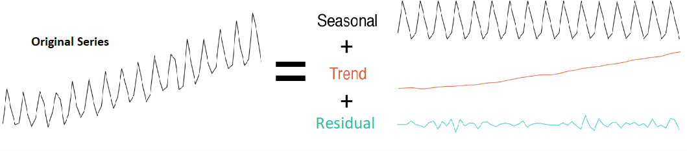
Time Series Decomposition
Time Series Decomposition is a technique to extract multiple types of variation from your dataset. There are three important components in the temporal data of a time series:
Seasonality,
Trend
Noise/Residual
Mathematically, can be represented as:
Y(t) = S(t) + T(t) + R(t)
Where,
S(t) = seasonal component,
T(t) = trend-cycle component
R(t) = is the remainder component

Slide 4


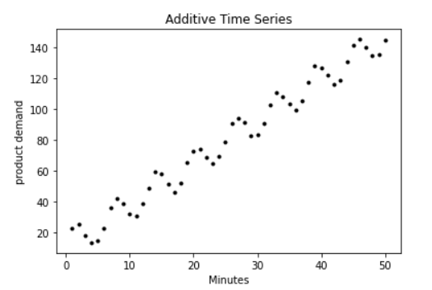
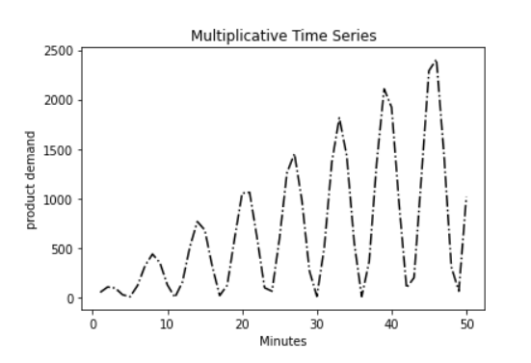
Types of decomposition model:
We use the following models when decomposing a time series:
Additive time series model.
Multiplicative time series model.
Additive Model | Multiplicative Model
In an additive time series, the components add together to make the time series. | In a multiplicative time series, the components multiply together to make the time series.

Slide 5
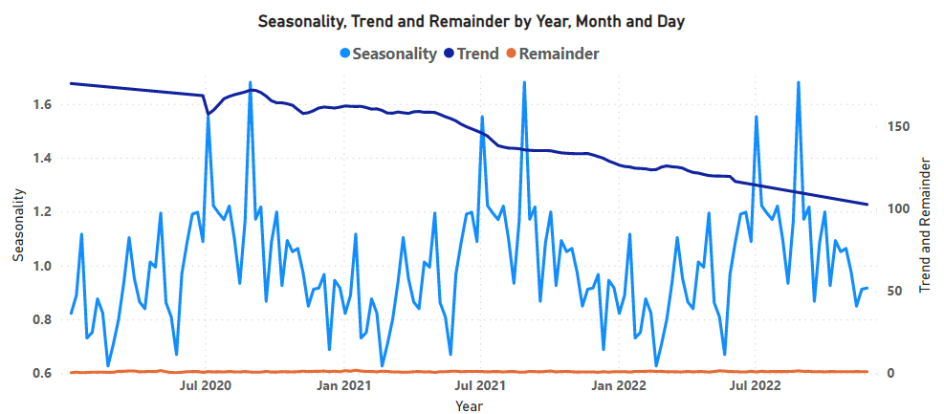
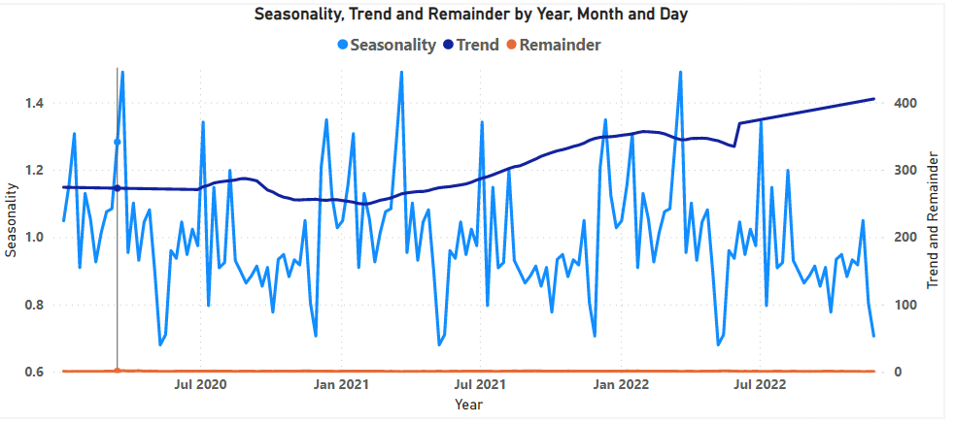
Decomposition on dataset:

Slide 6
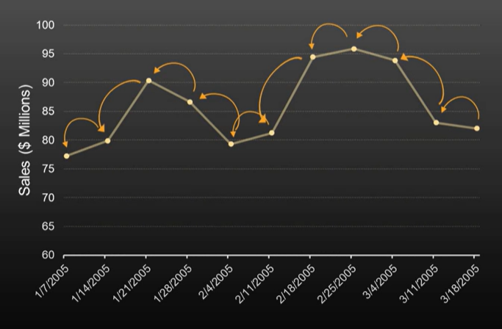
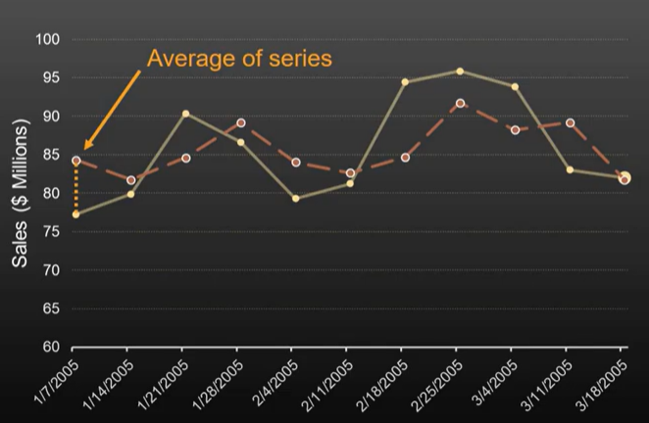
Forecasting Methods
Autoregressive Model (AR) | Moving Average Model (MA)
A statistical model is said to be autoregressive if it predicts future values based on previous values. Mathematically, it is denoted as – Yt = B1 (Yt-1) + B2 (Yt-2) Where, Yt = Predicted value for next time period. Yt-1 = Recorded value for immediate past time period. Yt-2= Immediate second past time period. B1, B2 = Coefficient of auto regression for immediate past time period value. | This model simply states that the next observation is the mean of past observations. The value at time (t) is calculated as the average of the raw observations at and before the time (t). MA(t)=mean(obs(t-2),obs(t-1), obs(t)) Where, MA(t)= Mean of observations Obs(t)= observations at current time. Obs(t-1)= observations at second past time. Obs(t-2)= observations at past time.

Slide 7
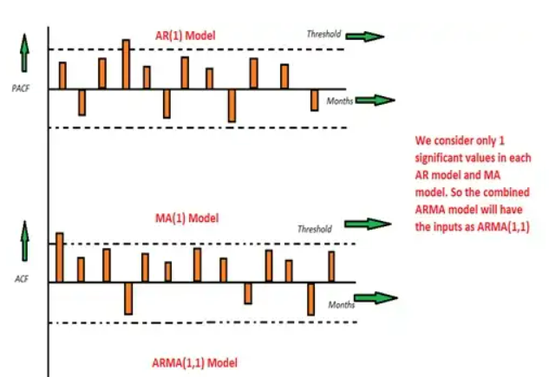
Choosing values for AR,MA
Autoregressive Model (AR) | Moving Average Model (MA)
PACF (Partial Auto-correlation Factor): The correlation between the observations at two time spots given that we consider both observations are correlated to the observations at the other time spots. | ACF (Autocorrelation Factor): It is the correlation between the observations at the current time spot and observations at the previous time spots.

Slide 8
SARIMA Model
SARIMA stands for Seasonal Autoregressive Integrated Moving Average. It is represented as:
SARIMA(p,d,q)(P,D,Q)S
No. of Seasonal Periods
No. of AR terms in PACF
No. of Seasonal MA terms in ACF
Order of differencing
Seasonal Order of differencing
No. of MA terms in ACF
No. of Seasonal AR terms in PACF

Slide 9
Thank you

